Slide 1

Competitive Programming From Problem 2 Solution in O(1)
P
T
H
I
N
K
F
A
S
T
S
The Compilation Process - 2
Mostafa Saad Ibrahim
PhD Student @ Simon Fraser University

Slide 2
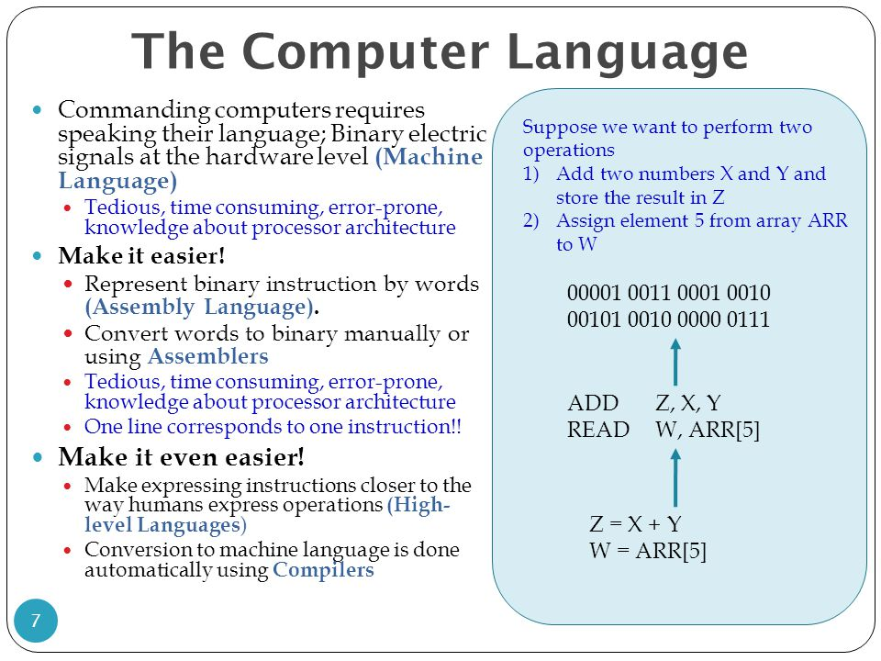
Last time summary
Notes:
http://images.slideplayer.com/11/3256549/slides/slide_7.jpg

Slide 3
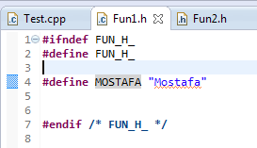
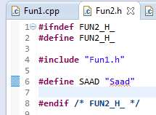
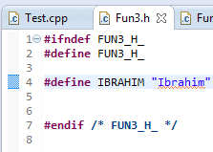
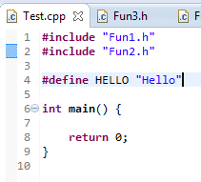
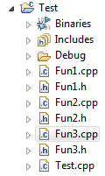

Simple Project

Slide 4
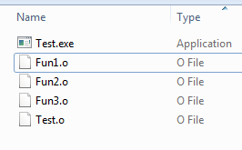
Let’s Compile and Check
5 binary files
=
4 object files
+
1 executable.
Right click on any
Select
Open with hexEdit

Slide 5
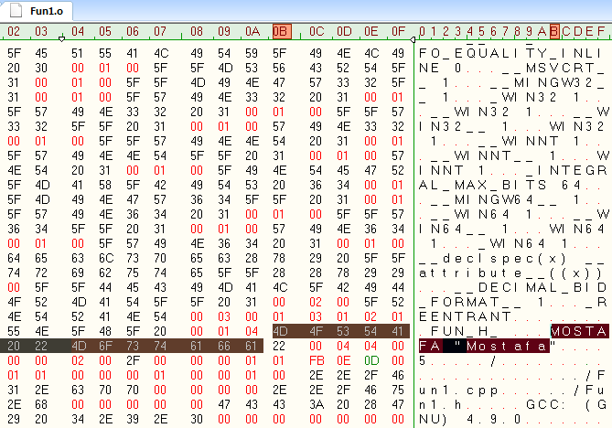
Fun1.o

Slide 6
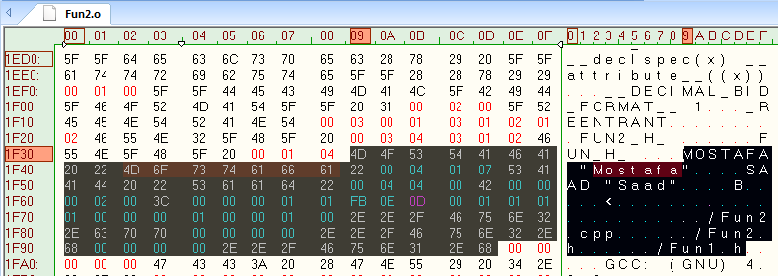
Fun2.o
It contains
Mostafa
Saad
As it include fun2.h includes fun1.h

Slide 7
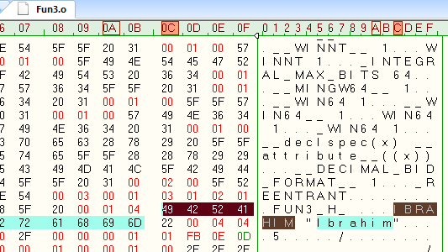
Fun3.o

Slide 8
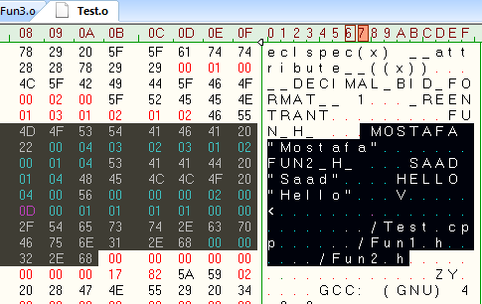
Test.o
It contains
Mostafa
Saad
Hello
BUT not
Ibrahim
As it did not include it

Slide 9
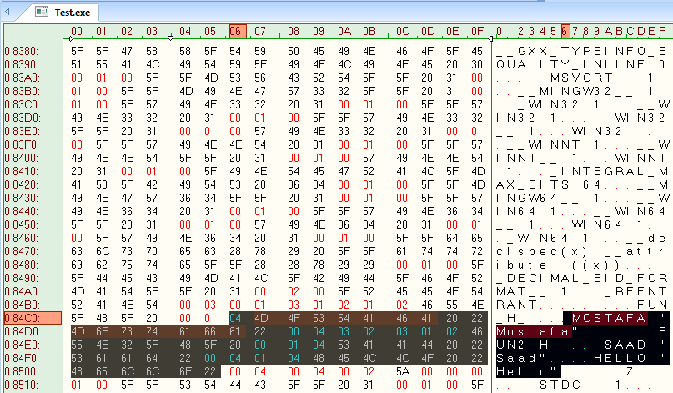
Test.exe

Slide 10
Overall
Project: 3 headers + 3 cpp + 1 main cpp
5 binary files (4 object files + exectuable)
Compiler generates 4 binary Object Files
Linker generates the exectuable
test.exe = Linking (fun1.o + fun2.o + test.o)
Linker => One that links the object files/libs
=> Generate Library / Executable

Slide 11
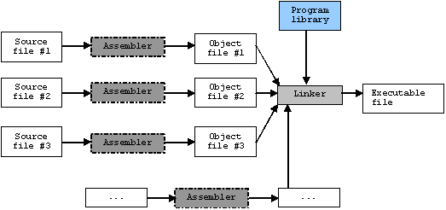
Linker Program
Compilation
E.g. C++
Standard Library
Notes:
http://www.tenouk.com/ModuleW_files/ccompilerlinker003.png

Slide 12
Compilation Process
Compiler
Source code => Compilation => Assembly Code
Assembly Code => Assembler => Object Files
Care with headers NOT implementation
Linker
Combine object files in final executable / library
Resolve references (search for the implementation of the referenced headers)

Slide 13
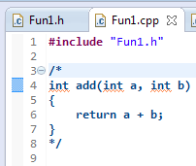
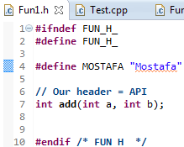
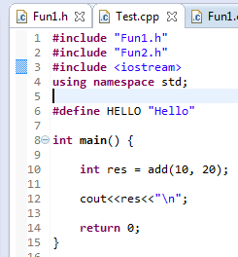
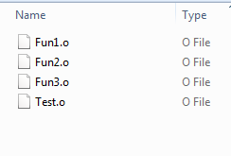
Modify Project
Compiled Sucessfully
4 object Files
Failed in Linking
=> No Executable

Slide 14
Linking Failure
In Compilation, we compile against the headers NOT the actual implementation
In linking, we connect against the actual implementation (static or dyanmic)
If the header has something we use, but implementation is not there, linking will fail...it will say undefined reference/symbol

Slide 15
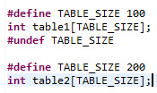

Remember Pre-Processor Program
Remove the comments
Process directives (#define, #include)
Generated
code

Slide 16
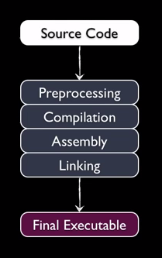
Summary
Src: https://www.youtube.com/watch?v=2dan4hJlOv0

Slide 17
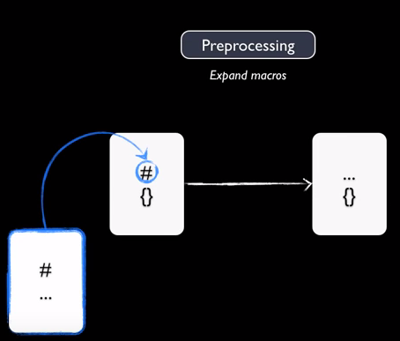
Summary

Slide 18
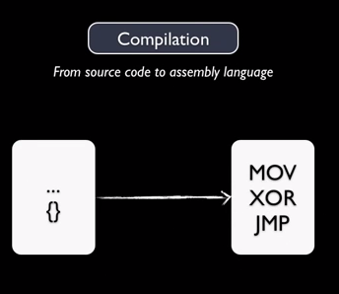
Summary

Slide 19
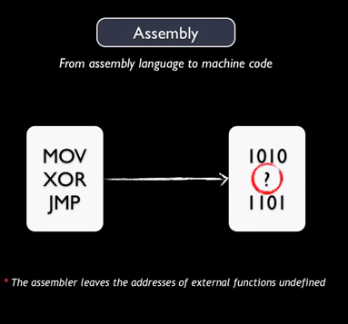
Summary

Slide 20
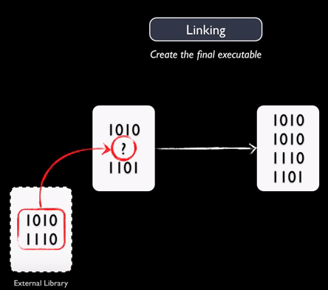
Summary

Slide 21
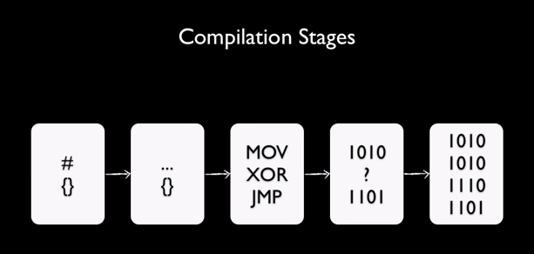
Summary

Slide 22
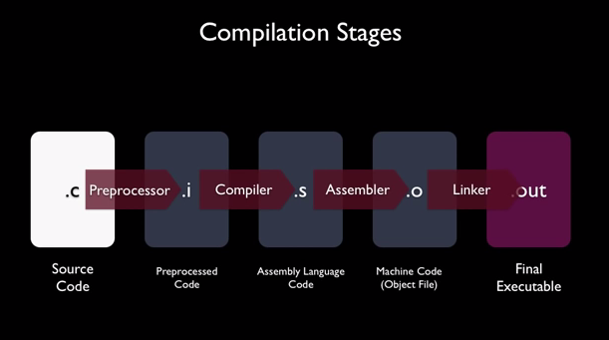
Summary

Slide 23
Summary
Involved programs
Editor (e.g. IDE / Notepad), Preprocessor, Compiler, Assembler, Linker, Loader
3 Ascii files
Source code, pre-processed source, assembly code
2 binaries styles
Set of binary object files
Final executable/library from whole process
2 Major steps: Compile, Link
Running the program => OS Loading

Slide 24
تم بحمد الله
علمكم الله ما ينفعكم
ونفعكم بما تعلمتم
وزادكم علماً

